Slide 1
Char Device Driver
( I/O Control )
Speaker: Richard Chen
Team: Firmware

Slide 2
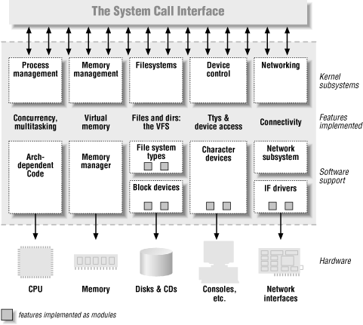


Motivation
Fundamental Device Driver
Understanding Register and Release Device Driver Flow

Slide 3
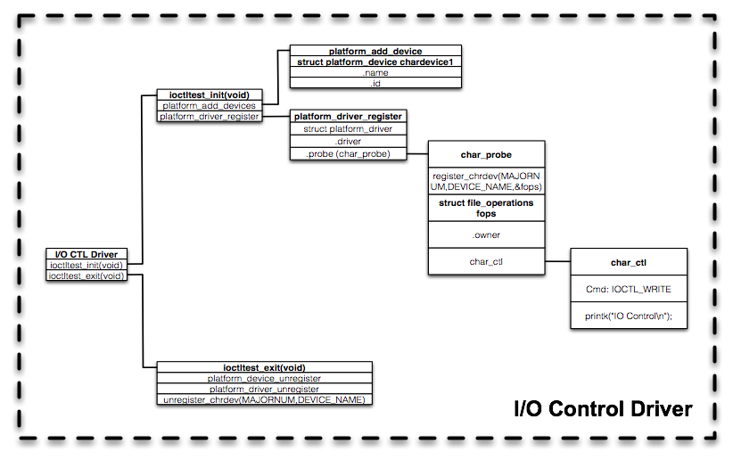
Flow Chart

Slide 4
Device Driver
Register Char Device Driver
Release Char Device Driver

Slide 5
Device Driver
Register Char Device Driver
Release Char Device Driver

Slide 6
Register Char Device Driver
Add Platform Device
Add Platform Driver
Register Char Device
Load Module Steps
App Test Result

Slide 7
Register Char Device Driver
Add Platform Device
Add Platform Driver
Register Char Device
Load Module Steps
App Test Result

Slide 8
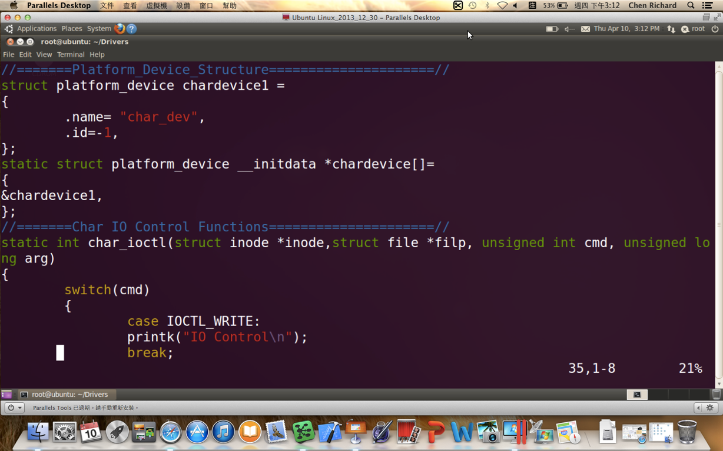



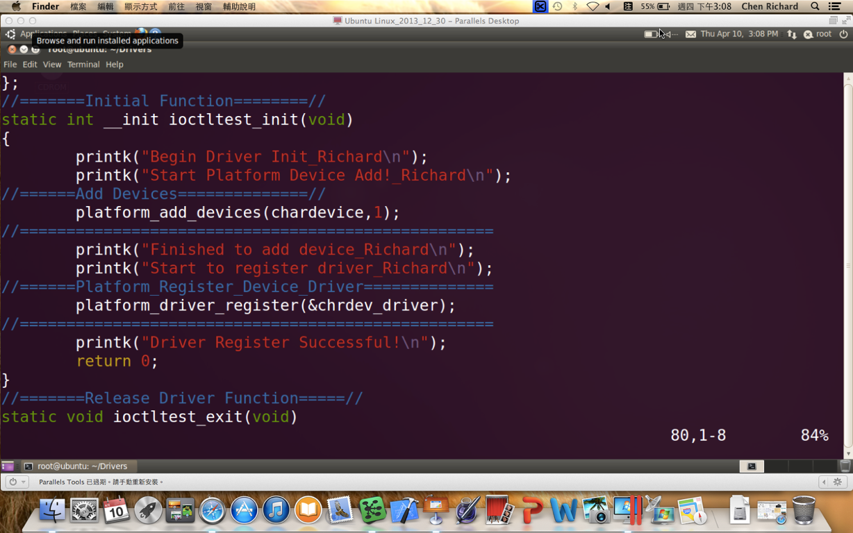

Add Platform Device
(3)
struct platform_device still can set another parameters.
Such_as: .resource (for ioremap)
(2)
(1)

Slide 9
Register Char Device Driver
Add Platform Device
Add Platform Driver
Register Char Device
Load Module Steps
App Test Result

Slide 10
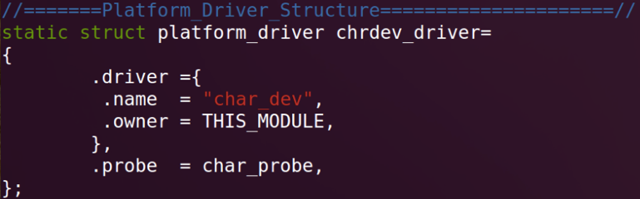



Add Platform Driver
(2)
struct platform_driver still can set another parameters.
Such_as: .remove (for release)
(1)

Slide 11
Register Char Device Driver
Add Platform Device
Add Platform Driver
Register Char Device
Load Module Steps
App Test Result

Slide 12


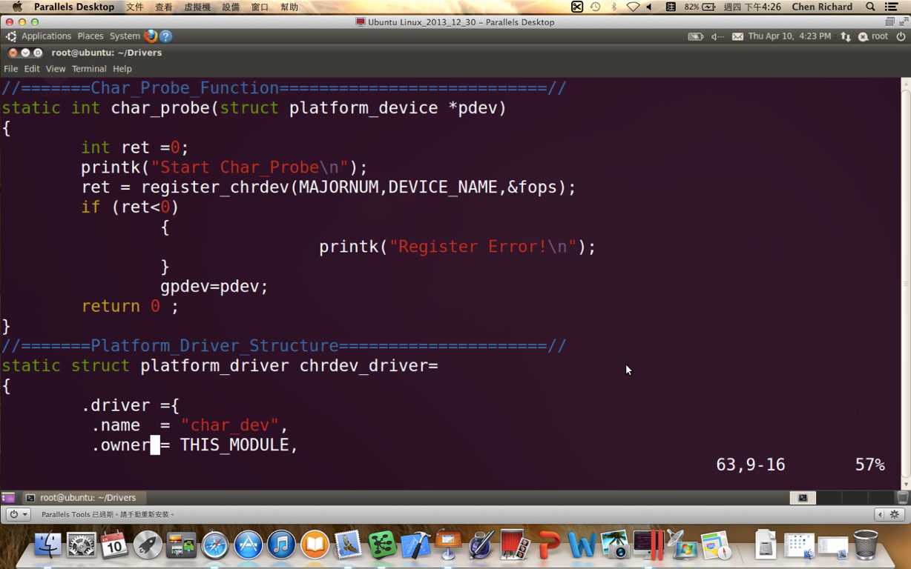

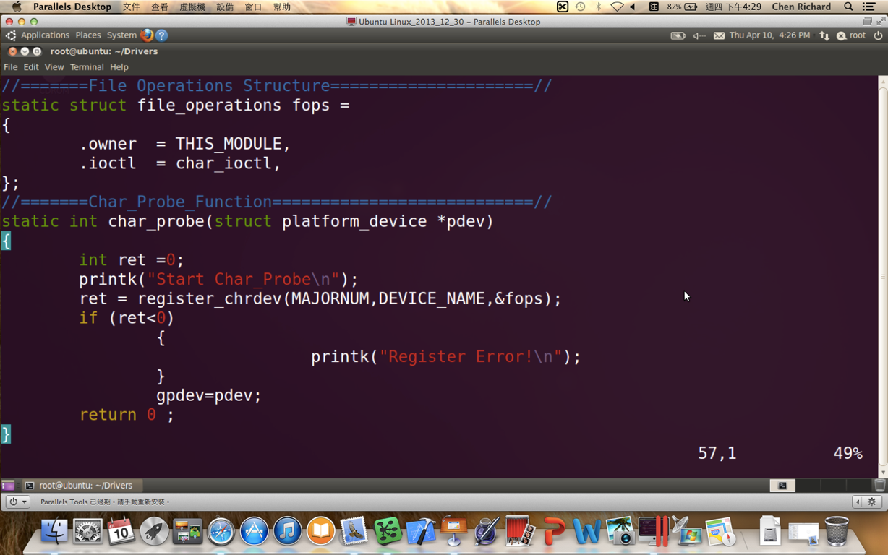

Register Char Device
Probe() Function:
Initial Function
Included Operation Functions
struct file_operations still can set another parameters.
Such_as:
.read (for read)
.write (for write)
(1)
(2)
(3)

Slide 13
Register Char Device Driver
Add Platform Device
Add Platform Driver
Register Char Device
Load Module Steps
App Test Result

Slide 14
Load Module Steps
Make to build .ko ( make )
Insert Module ( insmod char_dev.ko )
List Module ( lsmod | head )
Check Device ( cat /proc/devices )
Make Node
( mknod /dev/char_device c 60 0 )
Debug ( dmesg | tail )

Slide 15
Register Char Device Driver
Add Platform Device
Add Platform Driver
Register Char Device
Load Module Steps
App Test Result

Slide 16
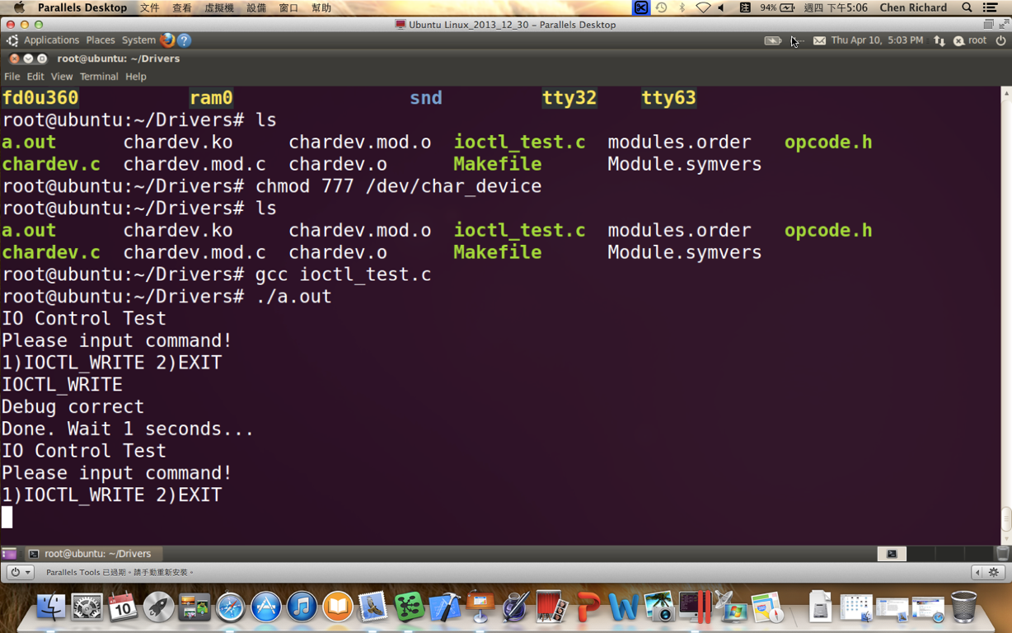



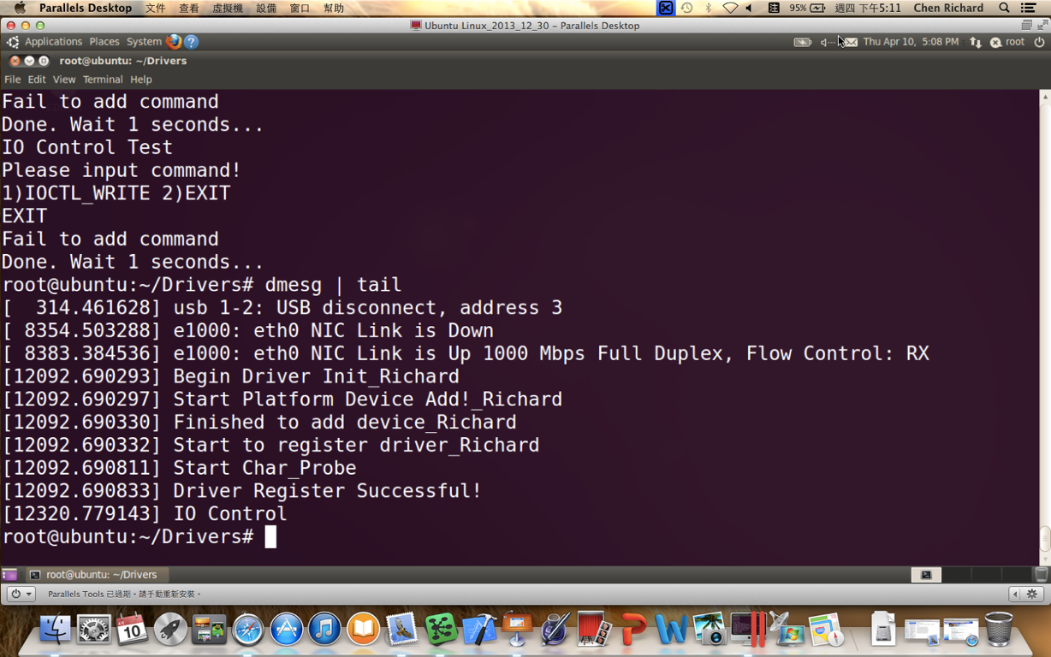
App Test Result
(App Name)
(I/O Command)
(Test Successful)

Slide 17
Device Driver
Register Char Device Driver
Release Char Device Driver

Slide 18
Release Char Device Driver
Unregister Platform Device
Unregister Platform Driver
Unregister Char Device
Unload Module Steps

Slide 19
Release Char Device Driver
Unregister Platform Device
Unregister Platform Driver
Unregister Char Device
Unload Module Steps

Slide 20
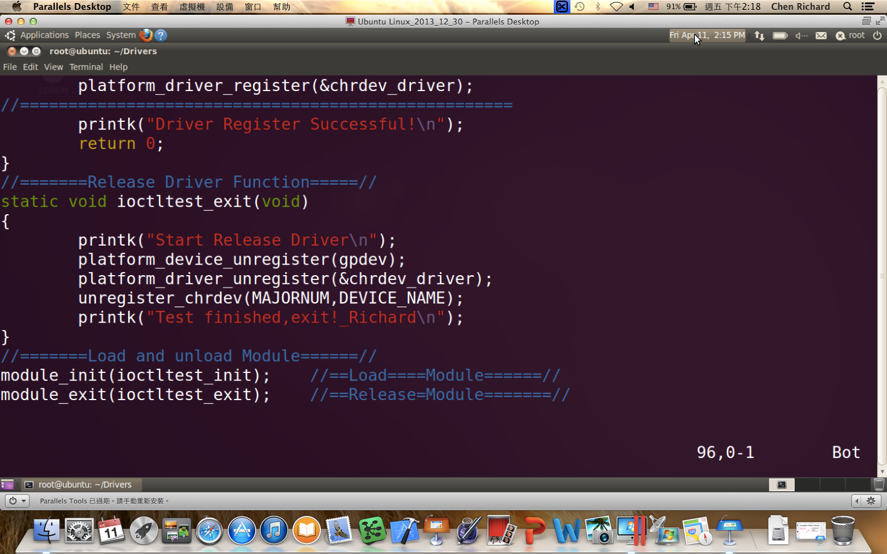


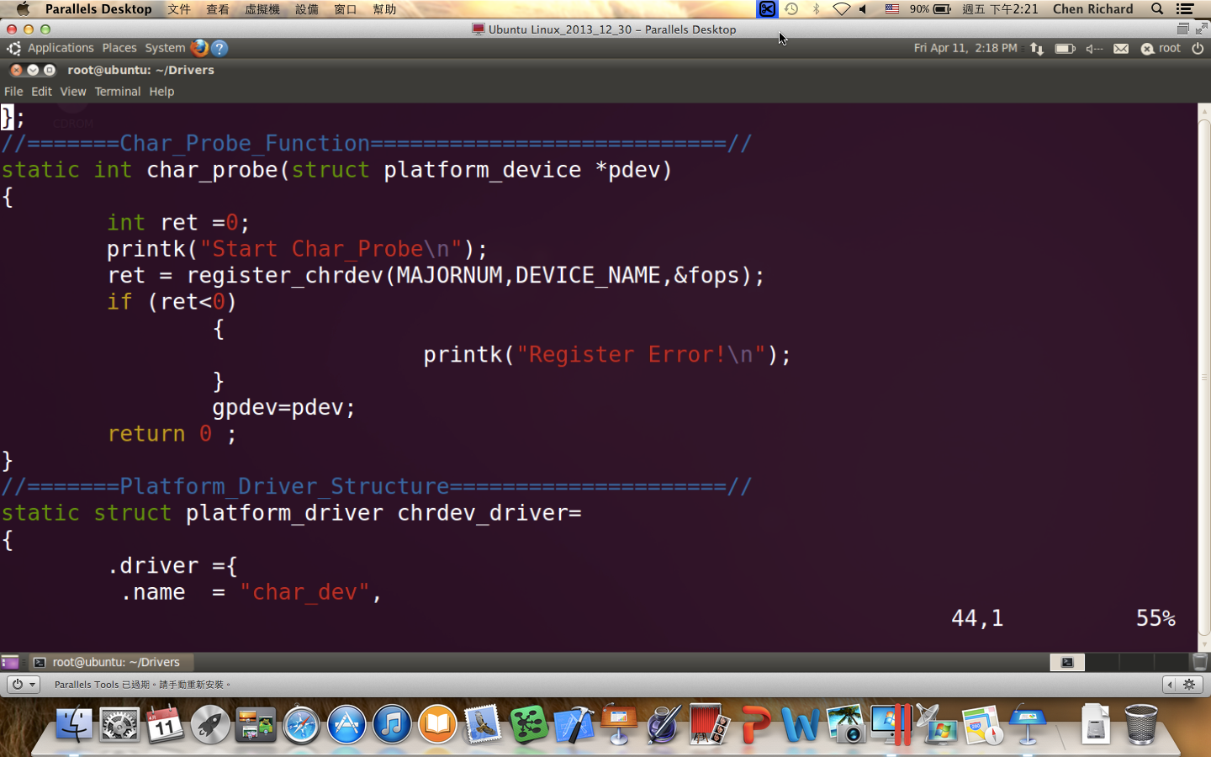
Unregister Platform Device
(1)
(2)

Slide 21
Release Char Device Driver
Unregister Platform Device
Unregister Platform Driver
Unregister Char Device
Unload Module Steps

Slide 22


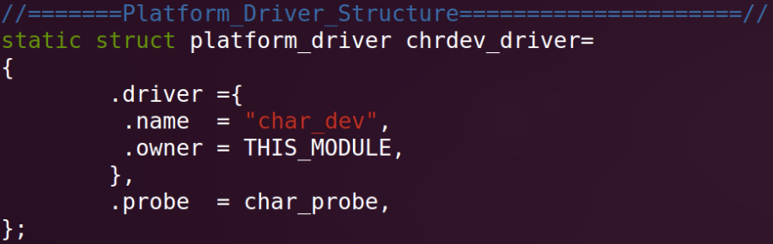
Unregister Platform Driver
(1)
(2)

Slide 23
Release Char Device Driver
Unregister Platform Device
Unregister Platform Driver
Unregister Char Device
Unload Module Steps

Slide 24

Unregister Platform Device
(1)

Slide 25
Release Char Device Driver
Unregister Platform Device
Unregister Platform Driver
Unregister Char Device
Unload Module Steps

Slide 26
Unload Module Steps
Remove Node ( rm /dev/char_device )
Release Module ( rmmod char_dev )
List Module ( lsmod | head )
Check Device ( cat /proc/devices )
Make Clean ( make clean)
Debug ( dmesg | tail )

